Slide 1
Essential Questions:
What was the impact of the Industrial Revolution in the U.S.?
What was the impact of the Industrial Revolution on the South, the North, and the West?
How did Eli Whitney’s invention of interchangeable parts for muskets influence the Industrial Revolution?
How did the cotton gin influence the growth of the South?

Slide 2
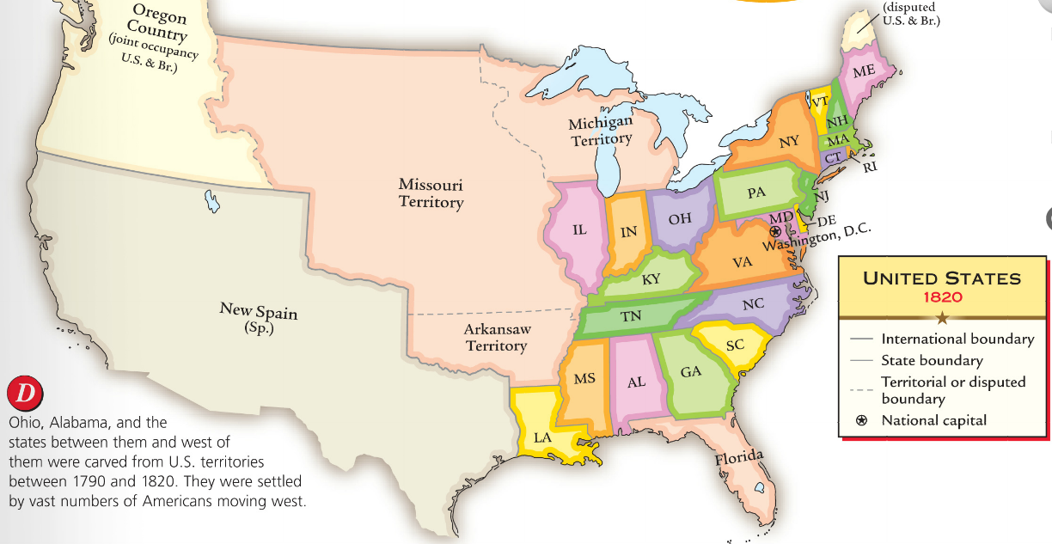
In the early Antebellum era (1800-1840), the U.S. economy grew rapidly because of an Industrial Revolution
The South, North, and West each developed specialized regional economies that became connected into a national market economy

Slide 3
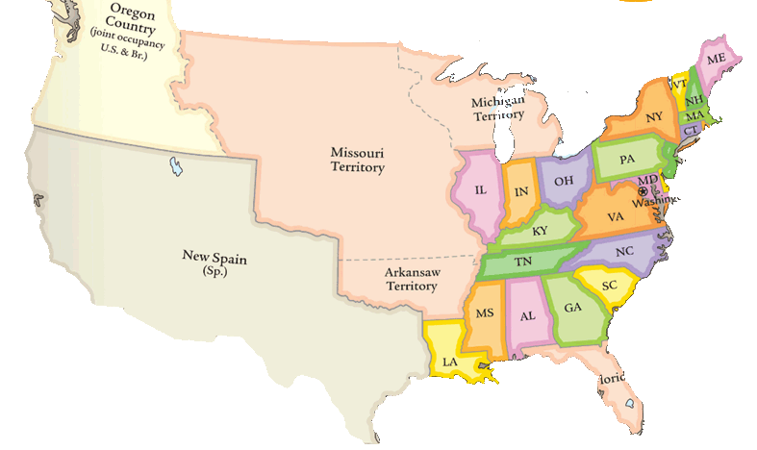
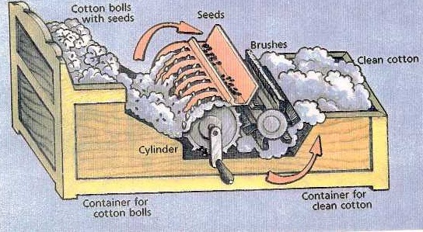
The South
What technology changed the South?

Slide 4
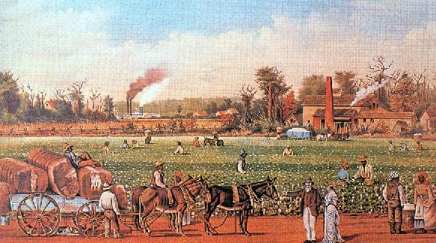
The South
What was the focus of the Southern economy?

Slide 5
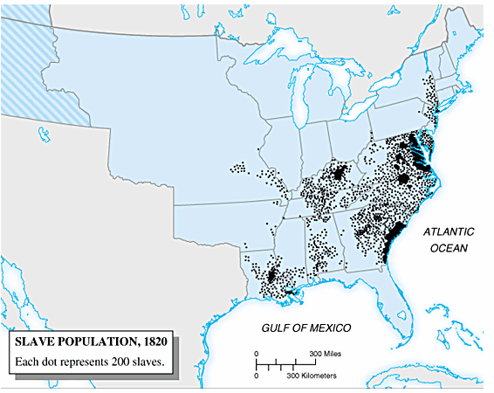
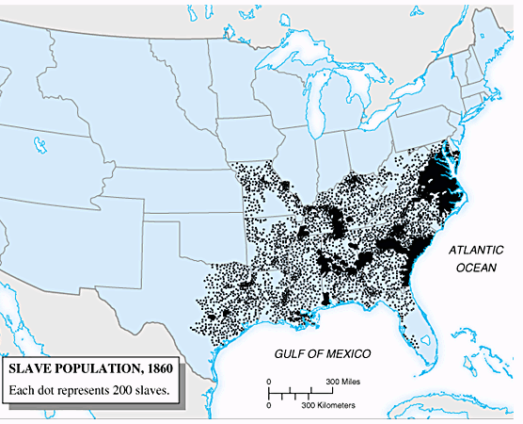
The South
What was the impact on the South?

Slide 6
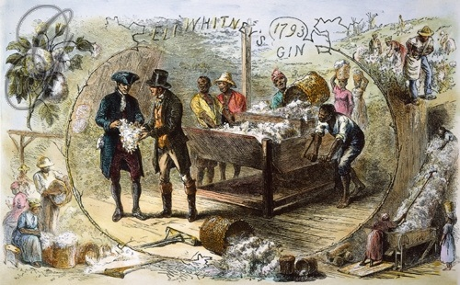
In 1793, Eli Whitney invented the cotton gin making cotton easy to refine and very profitable

Slide 7
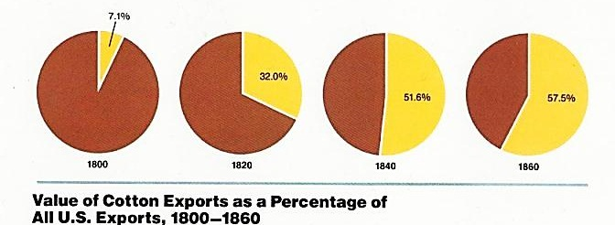
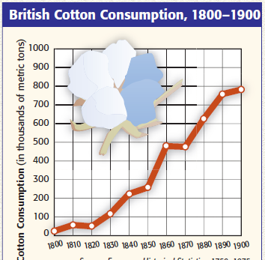
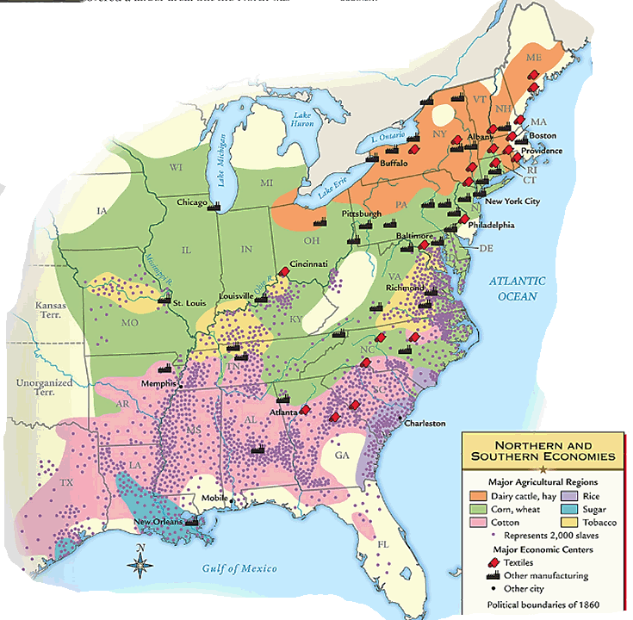
Cotton became the dominant cash crop of the Deep South (known as “King Cotton”)
The South provided 75% of world’s cotton and was the main U.S. export by 1840
Cotton stimulated Northern textile and shipping industries

Slide 8
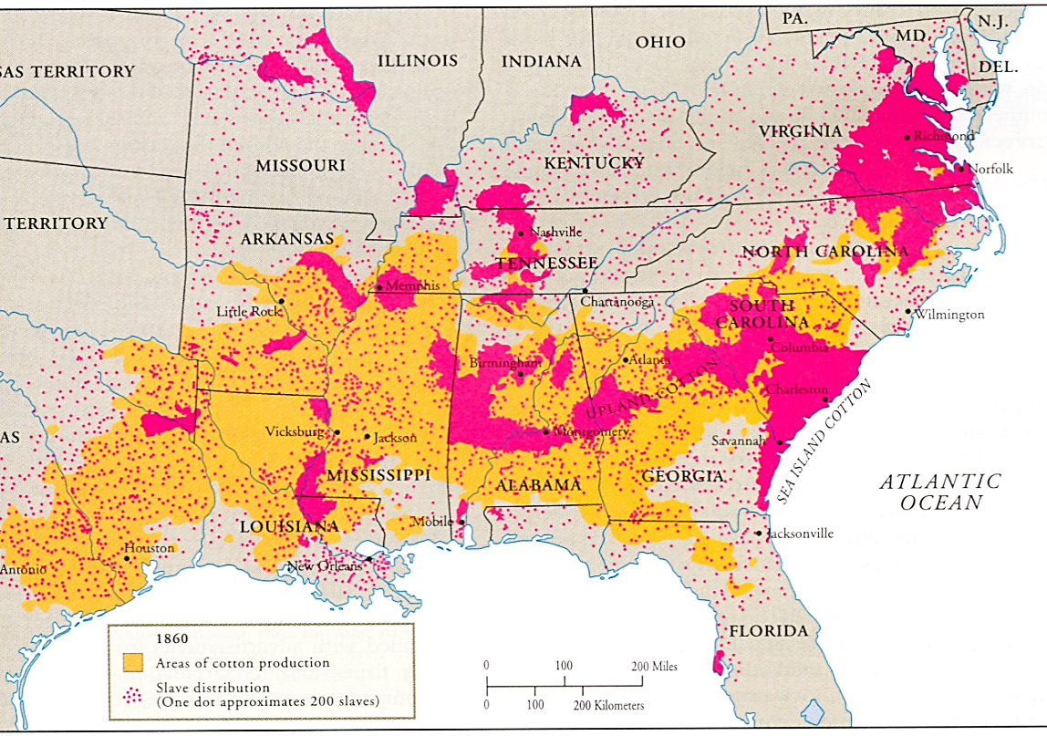
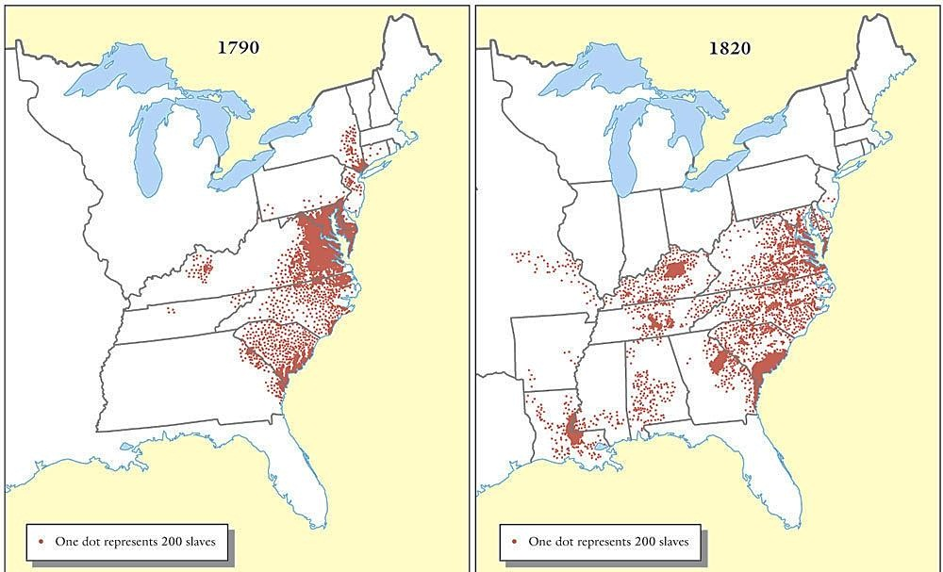
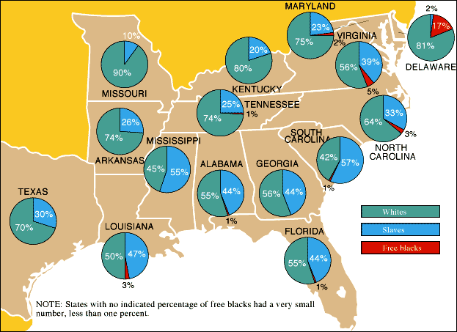
“King Cotton” had important effects on America
Cotton led to an increase in western expansion
Cotton led to an increase in slavery in the Deep South
The Black Belt

Slide 9
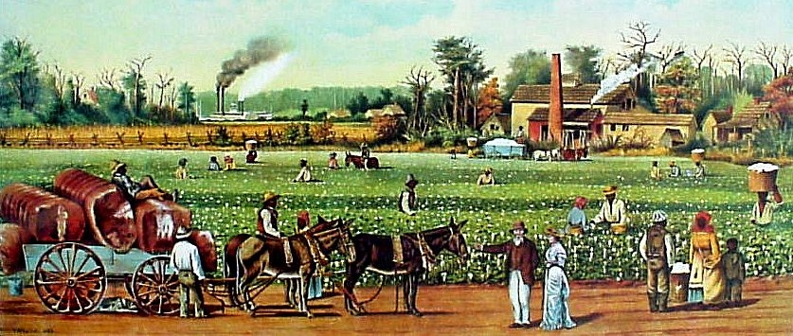
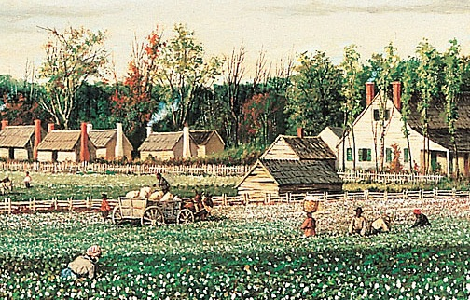
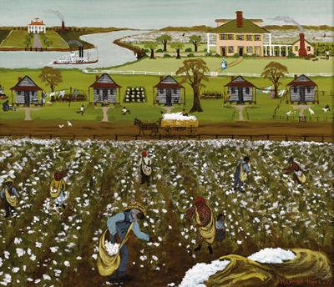

Slide 10
Distribution of Slave Labor, 1850

Slide 11
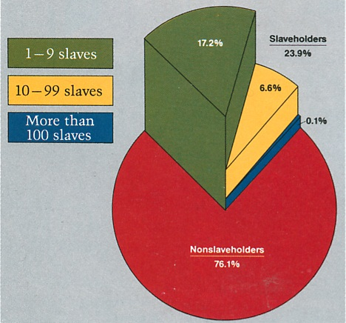
Only 25% of Southern whites owned any slaves; Those who did own slaves owned very few
However, most slaves lived on large plantations

Slide 12
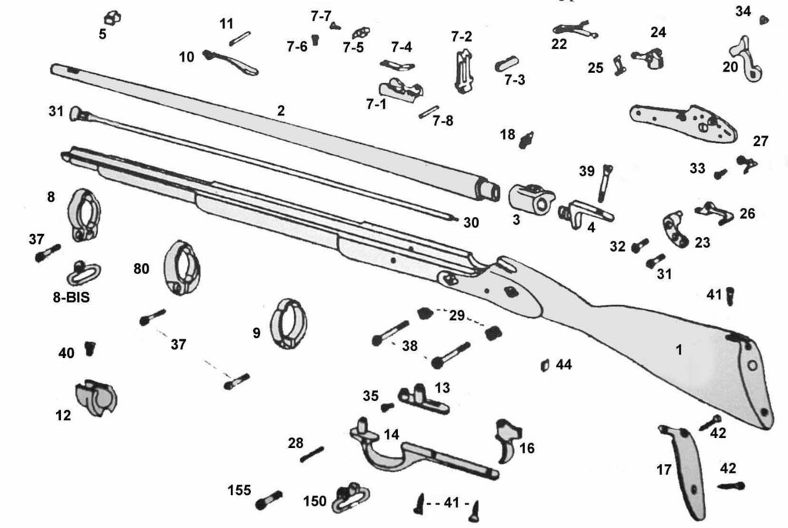
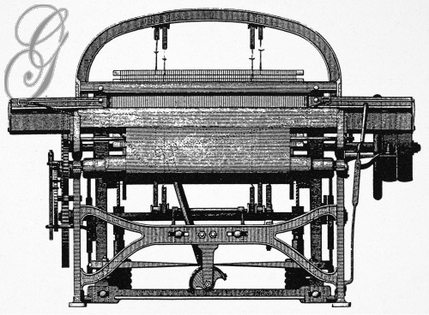
The North
What technology changed the North?

Slide 13
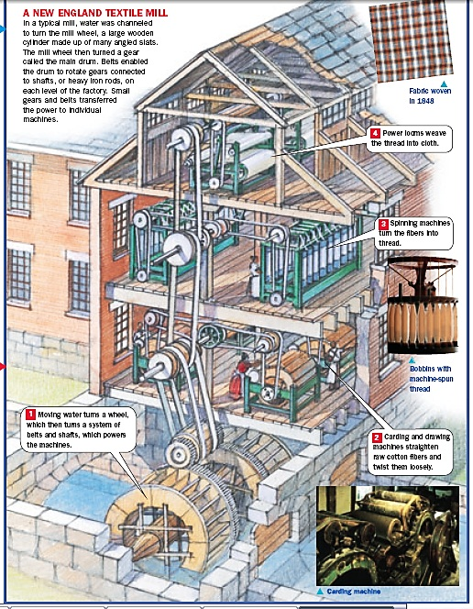
The North
What was the focus of the Northern economy?

Slide 14
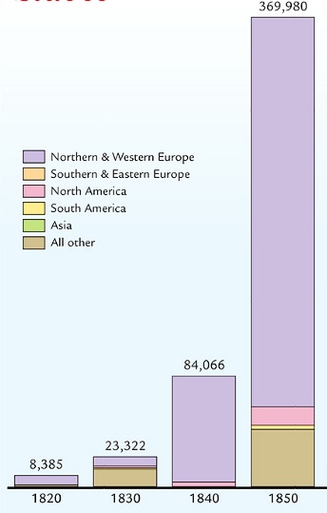
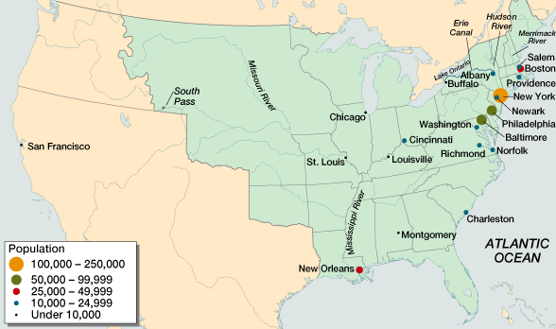
The North
What as the impact on the North?

Slide 15
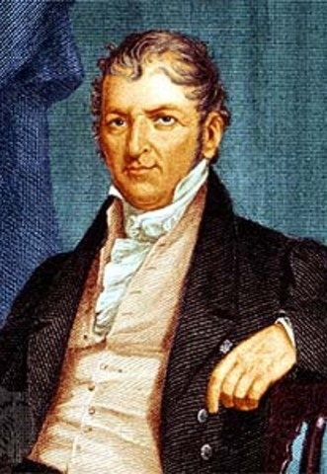
Eli Whitney’s development of interchangeable parts and new textile technologies led to an Industrial Revolution in the North

Slide 16
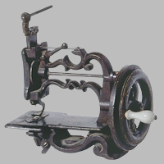
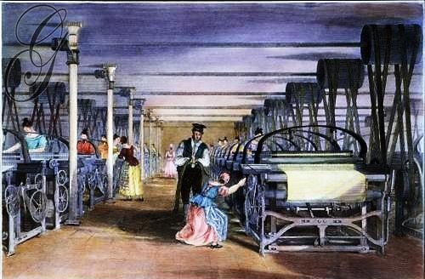
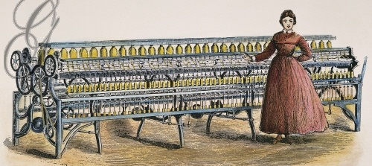
Sewing Machine
Power Loom
Spinning Mule

Slide 17
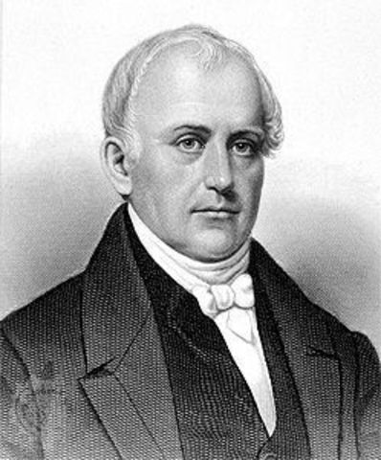
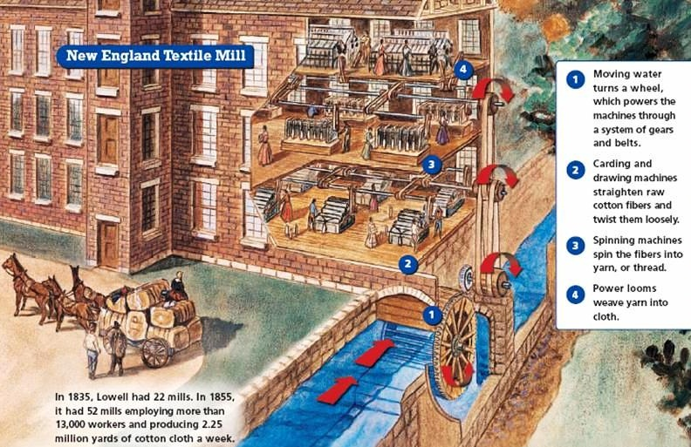
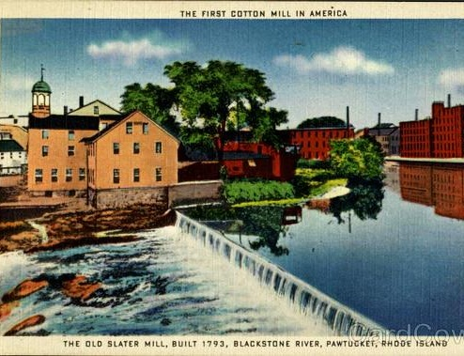
In the 1790s, Samuel Slater used British industrial designs to build the first American textile factories
In the early 1800s textile mills spread across New England

Slide 18
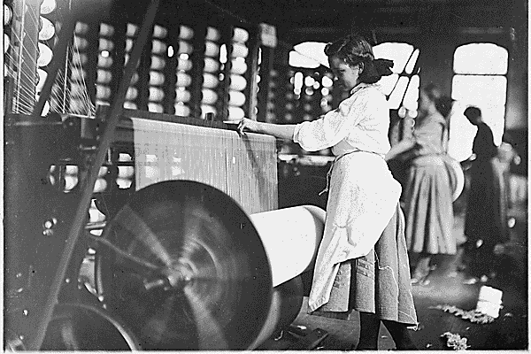
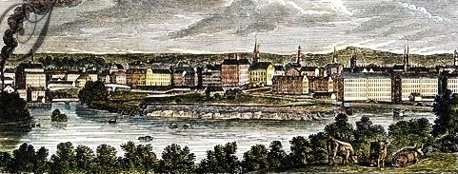
The most famous textile mill in America was the Lowell Mill in Boston
The Lowell Mill used mechanized machines to mass-produce textiles

Slide 19
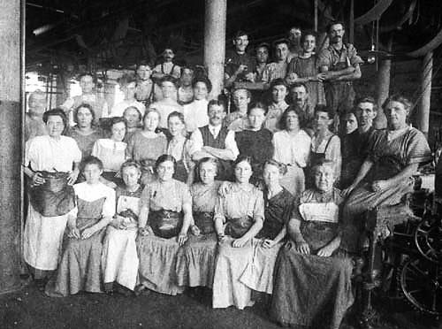
Lowell employed young women (“Lowell girls”) from the country who lived in boarding houses

Slide 20
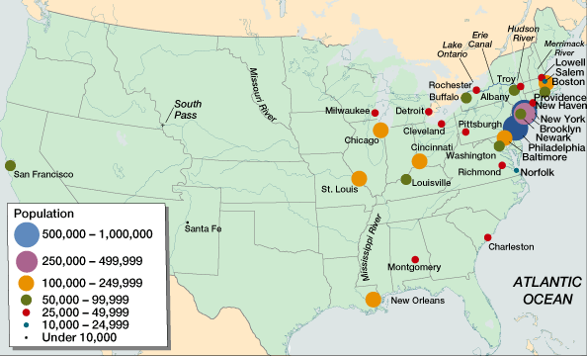
By 1840, Northern factories mass produced textiles, farm equipment, and other finished goods
The growth of factories led to an increase in American cities (called urbanization)
American cities in 1860
American cities in 1820

Slide 21
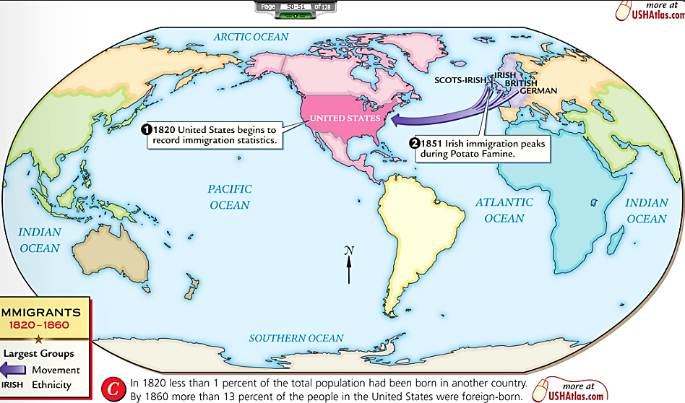
The growth of factories created jobs and led to an increase in European immigration to the United States
In the 1840s, millions of Irish and Germans immigrated to America
Immigrants worked in low-paying New England factories or moved west as farmers

Slide 22
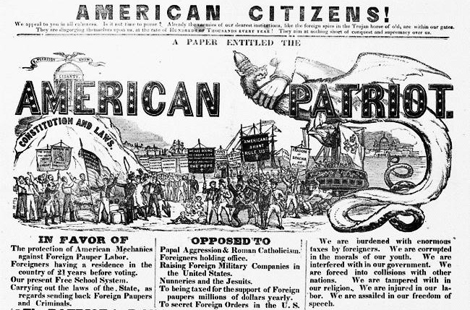
Rapid immigration led to hostility and prejudice by native-born Americans called nativism

Slide 23
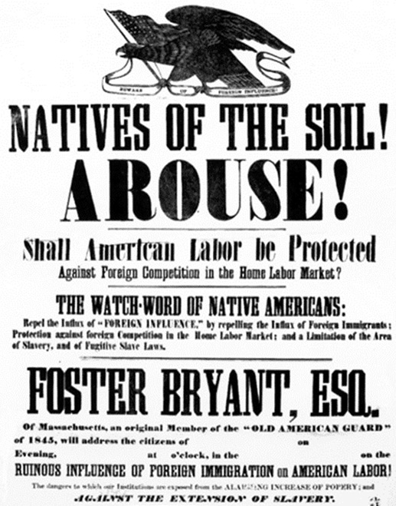
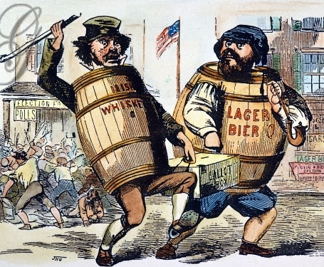
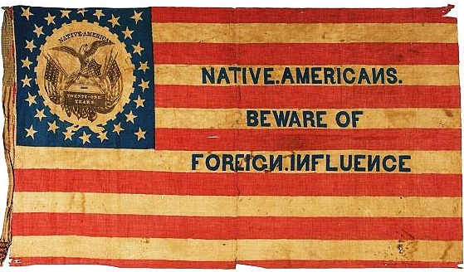
Nativists were worried that immigrants would vote, would remain poor and become a social burden, and that Catholic immigrants would remain loyal to the Pope
The Know-Nothing Party formed in the 1850s to restrict immigration and limit immigrant voting rights

Slide 24
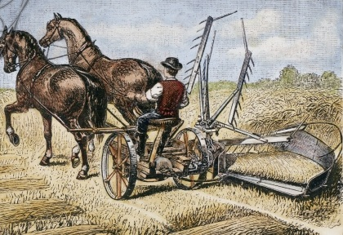
The West
What technology changed the West?

Slide 25
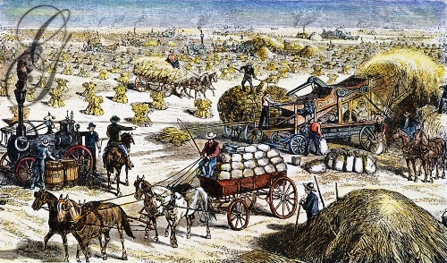
The West
What was the focus of the Western economy?

Slide 26
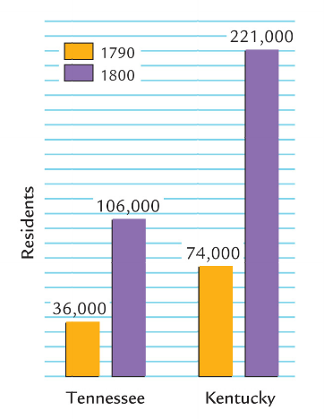
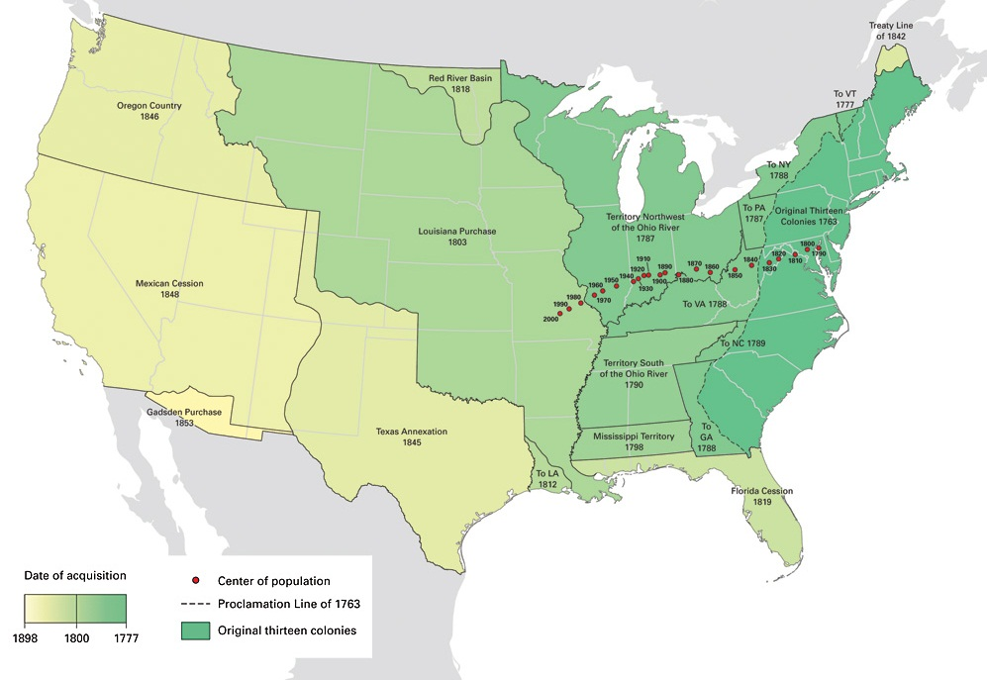
The West
What as the impact on the West?

Slide 27
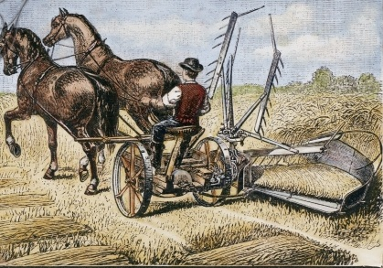
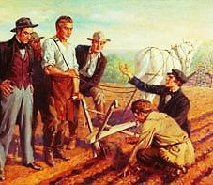
Cyrus McCormick’s mechanical reaper
New technologies made large-scale farming possible
John Deere’s steel plow

Slide 28
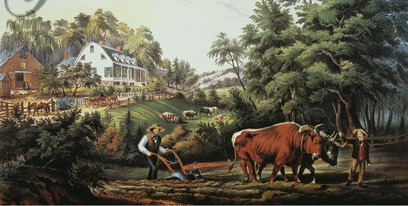
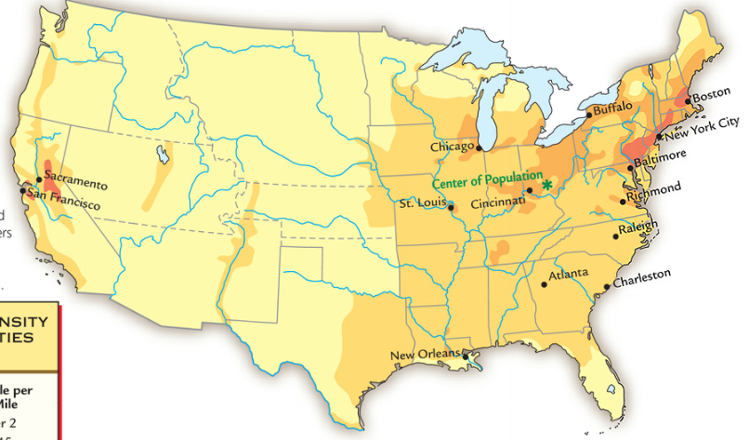
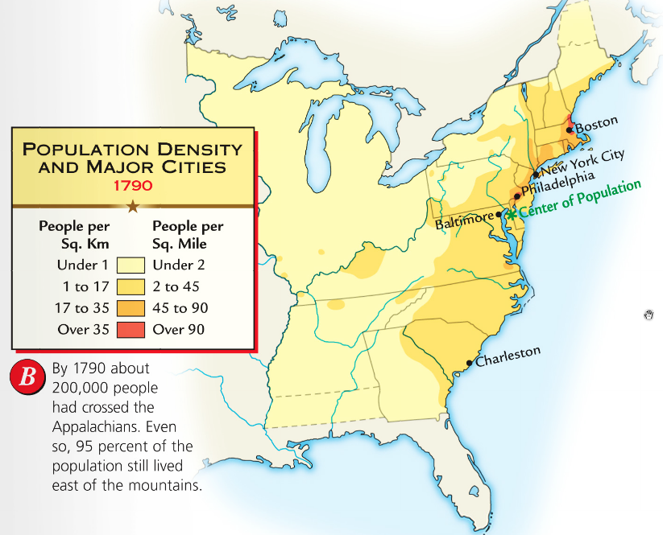
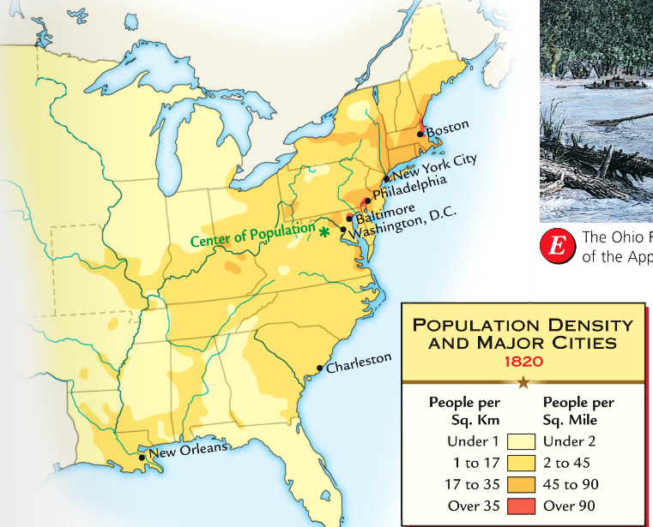
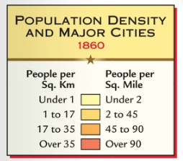
Population growth and land opportunities led to rapid growth of the West

Slide 29
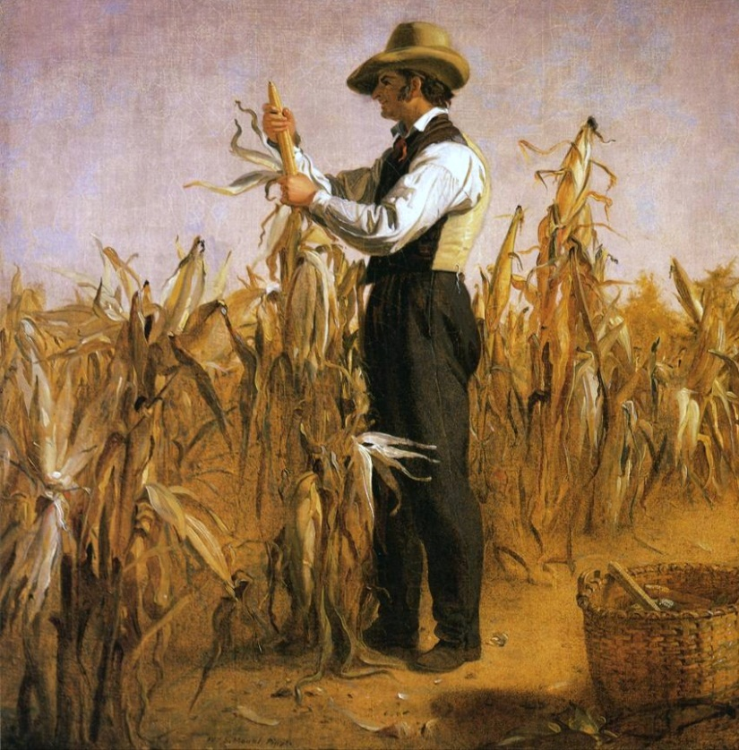
The West became “America’s bread basket” where commercial farms produced wheat, corn, livestock

Slide 30
From 1800 to 1840, these three regional economies became connected into a national market economy
Henry Clay’s American System helped connect the South, North, and West
American System created a tariff to promote Northern industry

Slide 31
The Second Bank provided federal money for investment and regulation over the U.S. banking system
The BUS held ~$10 million in federal money and loaned it to state banks which forced small banks to be smart when issuing loans
State banks loaned money to individual citizens, businesses, or local governments to finance roads, canals, factories, & farms

Slide 32
In the 1830s, railroad construction first began
The growth of trains was slow because they were expensive and competed with canals, but…
They were faster than
roads and canals, could travel in any season, and could go in any direction
By 1860, railroads were the dominant means of transportation in America
Notes:
In spite of such objections, it quickly became clear after 1830 that railroads were destined to become the nation's chief means of moving freight. During the 1830s, construction companies laid down 3,328 miles of track, roughly equal to all the miles of canals in the country. With an average speed of 10 miles an hour, railroads were faster than stagecoaches, canal boats, and steamboats, and, unlike water-going vessels, could travel in any season.

Slide 33
Essential Question:
- What is Manifest Destiny and how does it relate to westward expansion?

Slide 34
Monroe & the Republicans in Congress promoted nationalism & American unity in three ways:
Government: Increase the power of the national gov’t over the states
After the War of 1812, Americans flooded into the West; By 1840 over ¹/3 of the population lived in the West
Congress quickly admitted 5 new states to the Union
Economic and territorial growth created a need to settle America’s national borders
Economy: Encourage industry and transportation to link the South, North, and West
Indiana (1816)
Illinois (1818)
Alabama (1819)
Mississippi (1817)
Foreign Policy: Expanding America’s borders and increasing America’s role in world affairs
Louisiana (1812)

Slide 35
President Monroe and his Secretary of State John Quincy Adams used foreign policy to promote nationalism & territorial expansion
In 1818, the USA and Britain agreed to establish the Canadian border at the 49°
In 1819 the USA gained Florida from Spain with the Adams-Onís Treaty

Slide 36
Americans began to expand westward
Florida, the last piece of foreign territory in the east was acquired in 1819
50 years to reach the Mississippi River
The process of settlement took 150 years to reach the Appalachian Mountains
By 1850, Americans had settled California, Oregon and Washington

Slide 37
In 230 years, Americans had come to dominate the continent
Americans believed such rapid expansion a result of divine favor….

Slide 38
Manifest Destiny, a phrase coined to describe the belief that America was to expand and settle the entire continent of North America
America’s “Manifest Destiny to overspread the continent allotted by Providence for the free development of our yearly multiplying millions.” – John L. O’Sullivan

Slide 39
Mormons settled in western New York in 1827 when Joseph Smith established the Church of Jesus Christ of Latter-day Saints
They moved to Nauvoo, Illinois in 1839 where Smith’s neighbors spoke out against polygamy
Brigham Young moved the Mormons to Salt Lake City, Utah in 1847. Each family had common ownership of water and timberland

Slide 40
Closure Activity: Label each region of the nation and its economic specialty

